Slide 1

Global COVID-19 Data Analysis
Uncovering Hidden Patterns & Causality

Slide 2

Introduction: The Data Deluge
The COVID-19 pandemic generated vast data, offering unique insights into global health. However, complex data often leads to misinterpretations when correlations are mistaken for causation.
Problem Statement
Raw data can conceal underlying variables, leading to incorrect strategic conclusions. For example, high death rates in developed nations or low correlation between lockdowns and case reductions can be misinterpreted without accounting for demographics or lag effects.

Slide 3

Project Objectives
Our primary goal is to analyze global COVID-19 data using advanced statistical methods and Python visualization tools.
1
Correct Misleading Correlations
2
Evaluate Vaccination Effectiveness
Identify and rectify instances like Simpson’s Paradox.
Isolate cumulative data effects to assess true impact.
3
Assess Healthcare & Comorbidities
4
Analyze Government Policies
Analyze the impact of hospital capacity and comorbidities on mortality.
Evaluate the responsiveness of "Stringency Policies" to infection waves.

Slide 4


Data & Methodology
Data Source
Data Preprocessing
The comprehensive "Our World in Data" (OWID) COVID-19 dataset, aggregating information from WHO and Johns Hopkins University. Includes daily updates on cases, deaths, vaccinations, testing, and policy indices across 200+ countries.
Normalization: Absolute numbers converted to relative metrics (e.g., Deaths per Million).
Smoothing: 7-day rolling average applied to daily figures to mitigate noise.
Cleaning: Filtered out countries with missing data or populations under 1 million.
Feature Creation: Calculated Case Fatality Rate (CFR) as Total Deaths / Total Cases x 100.

Slide 5


Tools & Technologies
Our analysis was conducted using Python within a Jupyter Notebook environment.
Python 3.9
The core programming language for all analysis.
Pandas
Used for efficient data manipulation and time-series management.
Matplotlib & Seaborn
For generating static statistical correlations and regression plots.
Jupyter Notebook
The interactive environment for conducting and presenting the analysis.

Slide 6
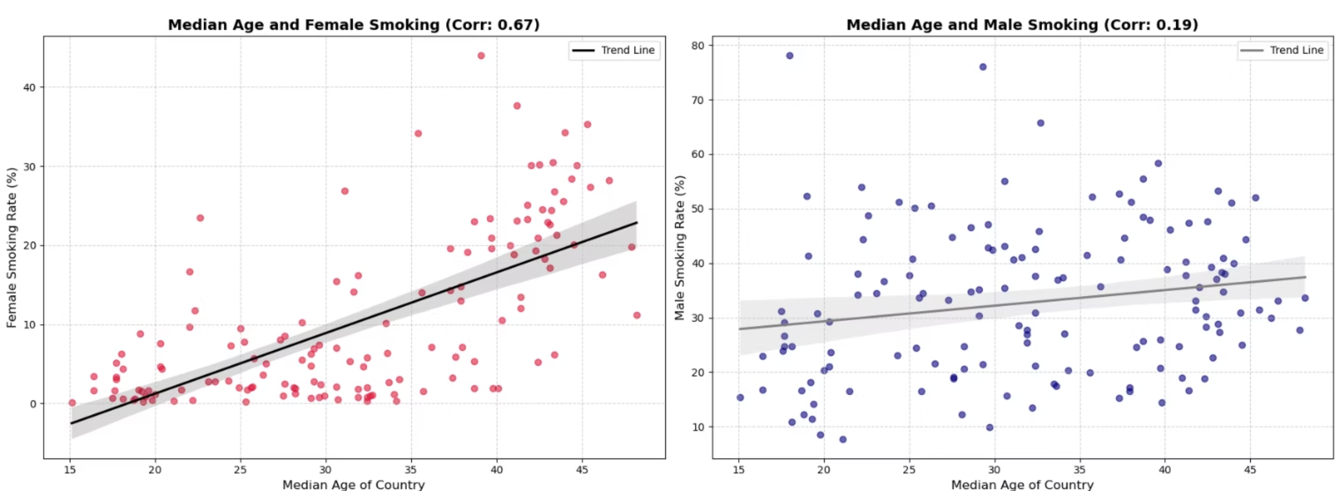
Demographic Paradoxes: Simpson’s Paradox
Initial analysis showed a misleading weak negative correlation (-0.07) between Female Smokers and Total Deaths per Million.
1
2
Root Cause
Correction
Developed nations with high smoking rates also have significantly older populations.
Isolating "Median Age" revealed a strong positive correlation (+0.65) with mortality, confirming age as a confounding factor.

Slide 7
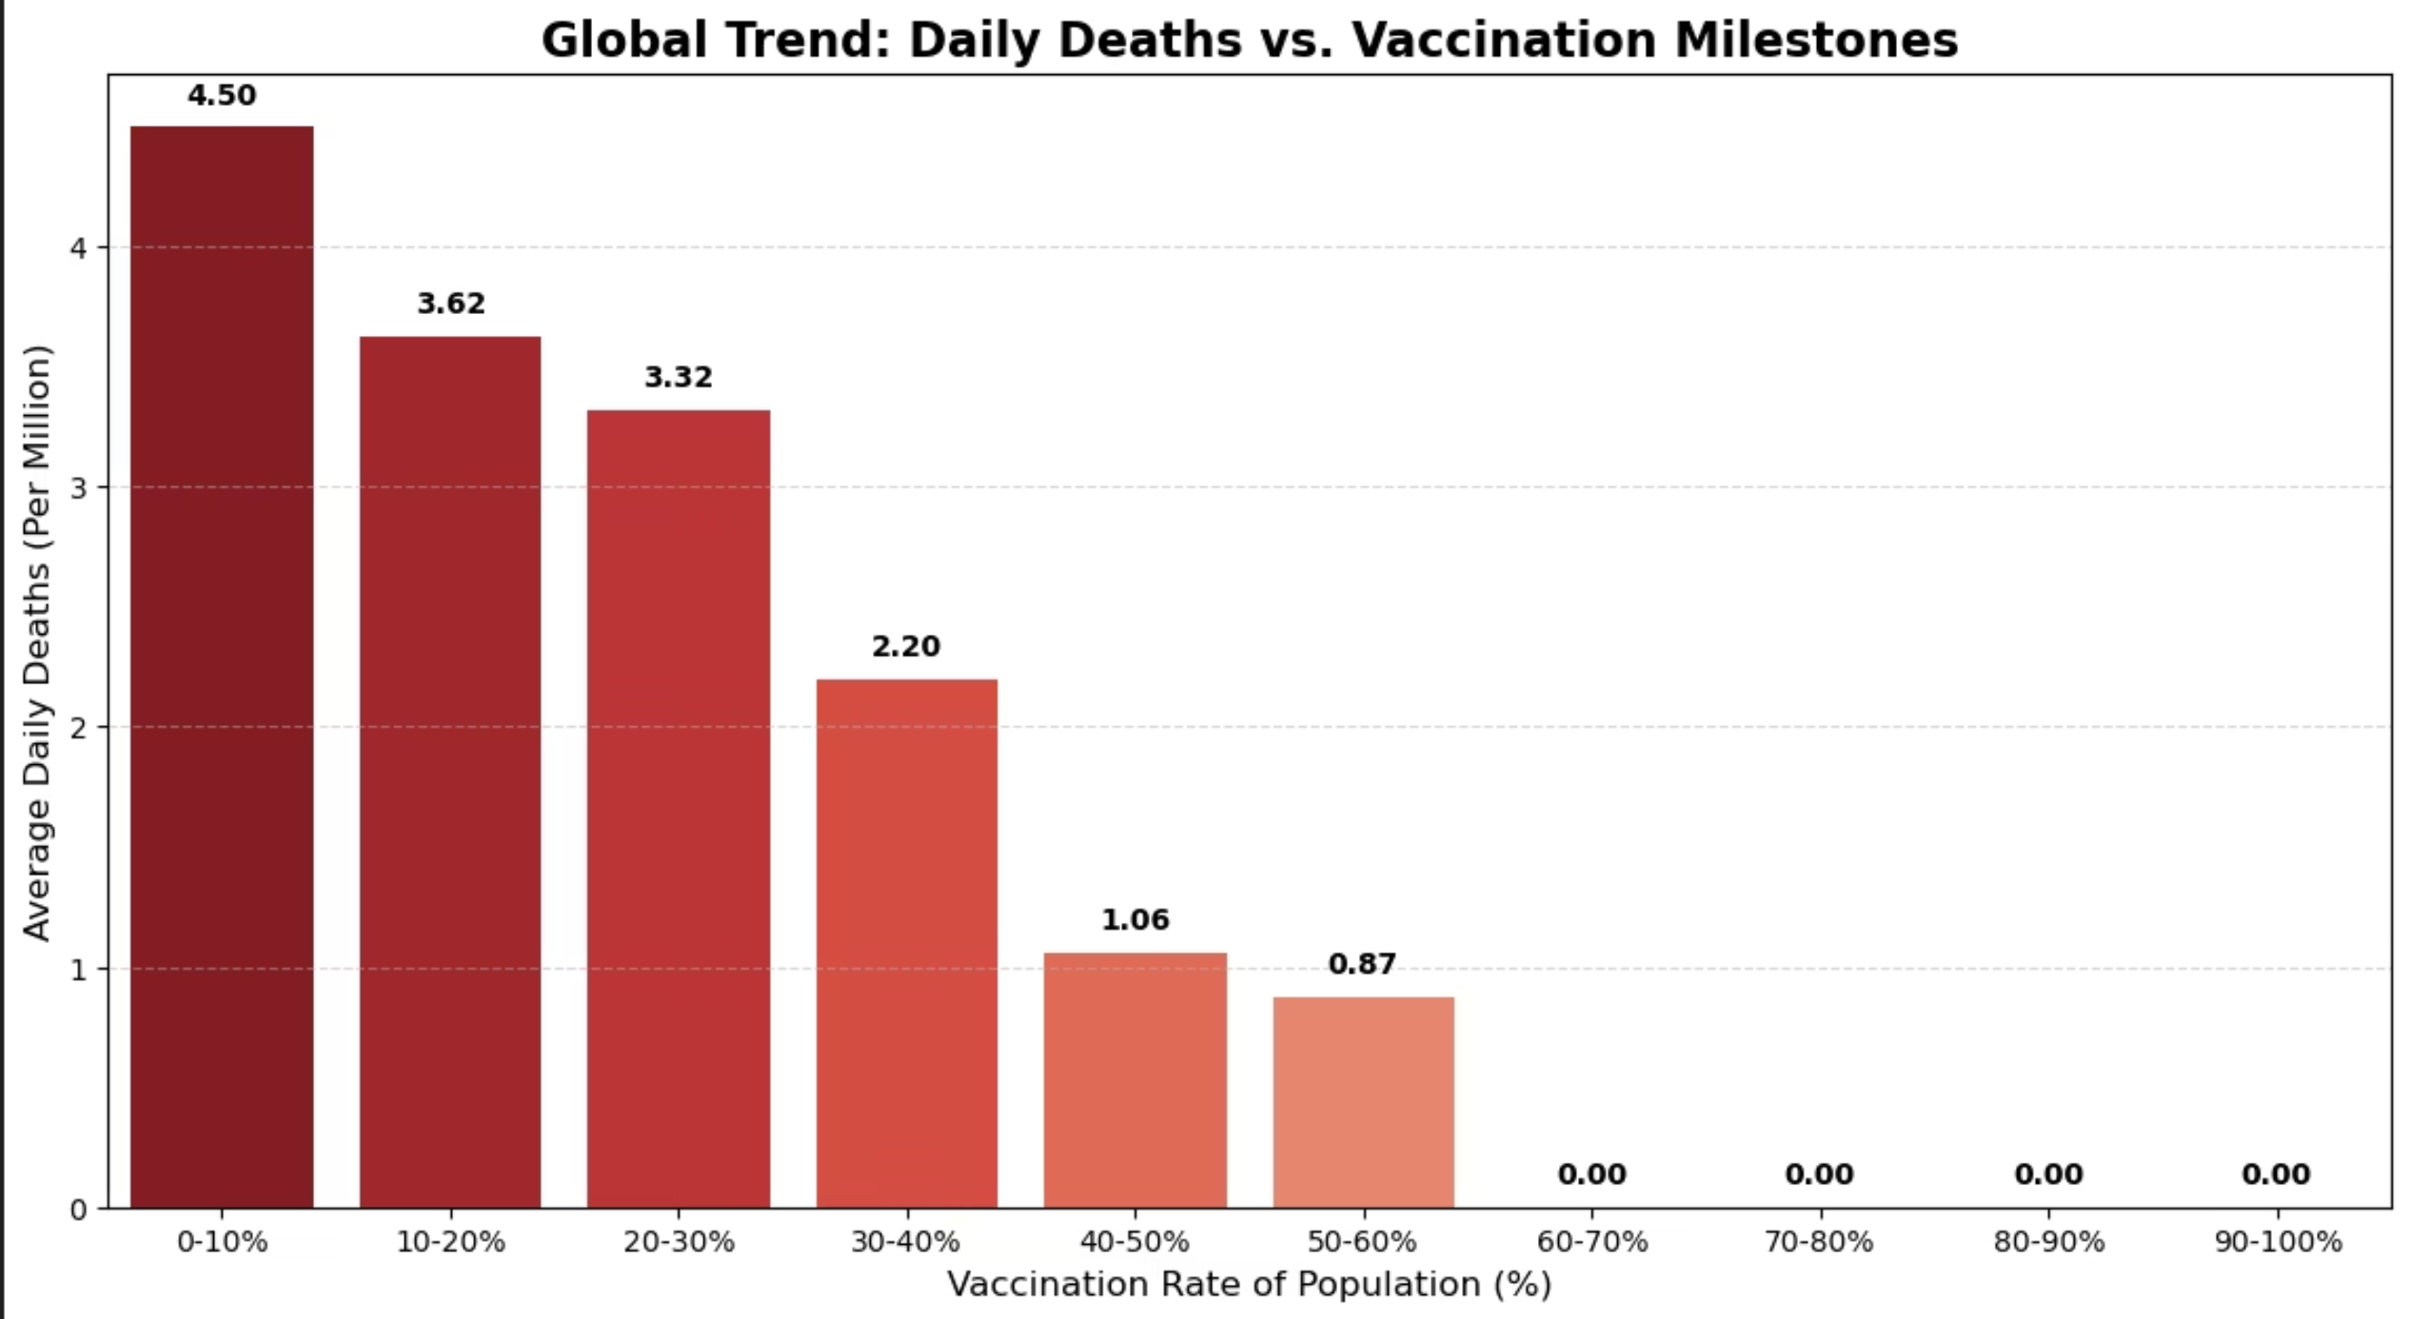
Efficacy of Vaccination
Initial attempts to correlate vaccination rates with cumulative deaths were skewed by the "Cumulative Trap" from the pre-vaccine era.
Methodology Shift
Clear Findings
Adopted a "Binning" approach, examining Average Daily Deaths (per million) at different vaccination coverage milestones.
As countries moved from 0-10% to >60% vaccination, daily death rates per million dropped significantly, proving vaccines reduce concurrent mortality risks.

Slide 8
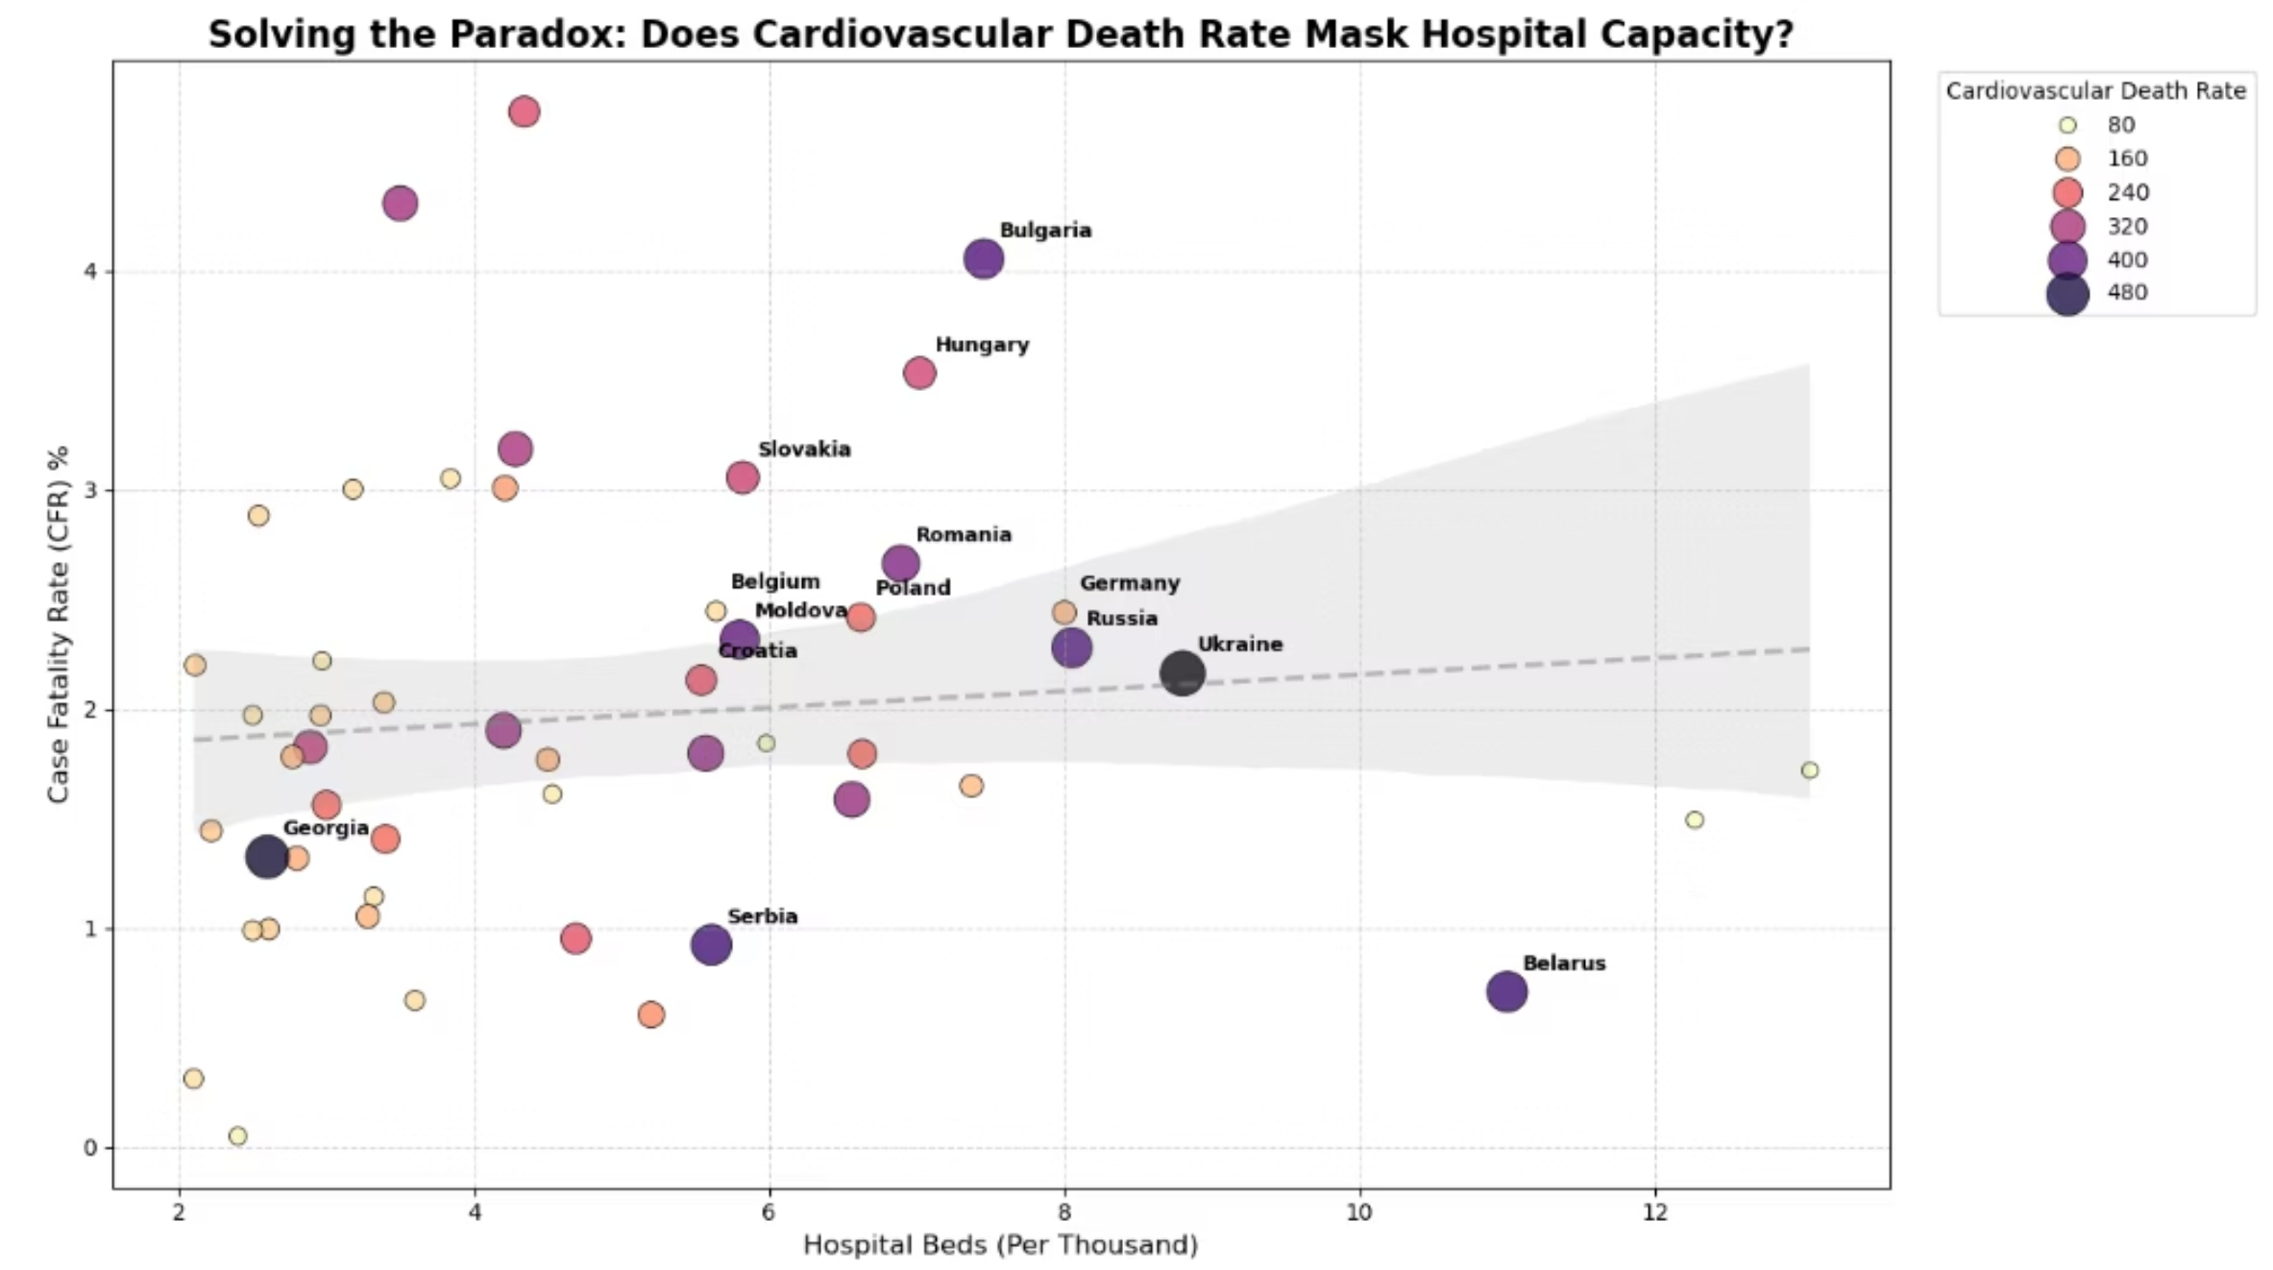


Socio-Economic Factors & The Healthcare Paradox
Hypothesis: Higher hospital capacity would lead to lower mortality rates. Anomaly: Developed nations (Median Age > 35) showed neutral to slightly positive correlation between bed capacity and death rates.
Root Cause
Introducing Cardiovascular Death Rate as a third variable resolved the paradox. Countries with high hospital capacity but high mortality clustered in regions with severe chronic health issues.

Slide 9
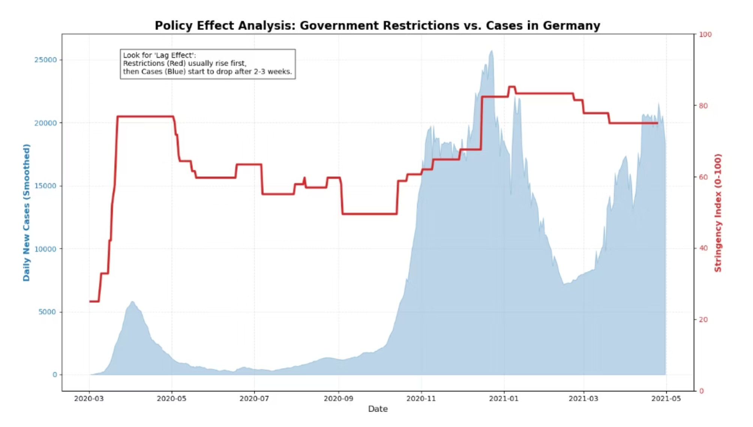
Evaluation of Government Policies: The Reactive Cycle
Analysis of government restrictions (Stringency Index) and infection waves revealed a consistent "Lag Effect."
1
Observation
Stringency Index spiked after exponential rises in cases had already begun.
2
Interpretation
This indicates "Reactive Policy Making," where restrictions acted as emergency brakes, lagging behind the virus's transmission speed.

Slide 10

Conclusion & Recommendations
Raw data in global health crises can be deceptive without contextual layering.
Summary of Insights
Strategic Recommendations
Demographics Matter: Age structure correlates more with mortality than behavioral factors.
Data Granularity: Use stratified data (age, comorbidities).
Vaccines Save Lives: High efficacy in reducing daily death rates.
Preventative Health: Invest in reducing chronic disease.
Chronic Health is Key: Infrastructure can't compensate for high comorbidity rates.
Early Warning Systems: Transition to predictive triggers for policy.
Policy Timing: Government interventions were often reactive.

